Slide 1

.NET Framework Architecture
Svetlin Nakov
National Academy for Software Development
academy.devbg.org

Slide 2

Contents
What is .NET?
  Microsoft .NET platform architecture
What is .NET Framework?
  .NET Framework Architecture
Common Language Runtime (CLR)
Managed Code
Intermediate Language MSIL
Assemblies and Metadata
Notes:
<number>##
<footer>*
<header>*
<date/time>07/16/96

Slide 3
Contents (2)
.NET Applications
Common Language Infrastructure (CLI) and integration of different languages
  Common Language Specification (CLS)
  Common Type System (CTS)
Framework Class Library
Integrated Development Environment Visual Studio
Notes:
<number>##
<footer>*
<header>*
<date/time>07/16/96

Slide 4



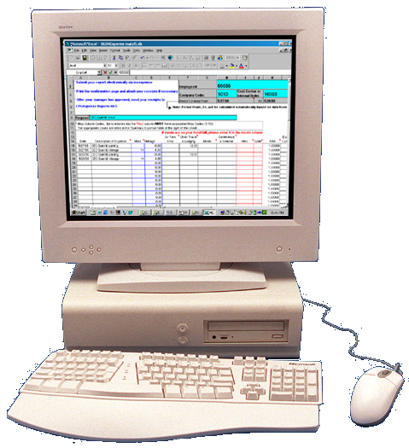








Microsoft Vision about .NET
Users
Every device
Everywhere
Always
XML Web Services
Integration between business processes and applications
Notification
Authentication
Orders
Reports
Queries
Server side
Heterogeneity server infrastructure
Sales Management
Customers and Partners Management
Business Management
Notes:
<number>##
<footer>*
<header>*
<date/time>07/16/96

Slide 5
What is .NET Platform?
Combination of technologies
  Connecting people with information
  Everywhere, every device and always
Standard infrastructure for developing, using and hosting of software applications and web services
.NET – Microsoft's vision about software technology development
The platform supporting this vision
Notes:
<number>##
<footer>*
<header>*
<date/time>07/16/96

Slide 6
.NET Framework

Slide 7
What is .NET Framework?
An environment for developing and executing .NET applications and Web services
Programming model, class library
and homogeneous infrastructure for developing
Controlled execution of managed code
.NET Compact Framework
  Used for execution of .NET applications on mobile devices
Notes:
<number>##
<footer>*
<header>*
<date/time>07/16/96

Slide 8
What is .NET Framework 2.0?
Version 2.0 of .NET Framework introduces many advantages (compared to version 1.1)
  C# language version 2.0 –
  parameterized (generics), nullable types
  ASP.NET 2.0 – master pages, new controls, better integration with databases, easier development
  ADO.NET 2.0 – added components
  Windows Forms 2.0 – added components
Notes:
<number>##
<footer>*
<header>*
<date/time>07/16/96

Slide 9
.NET Framework Components
Common Language Runtime (CLR)
  Environment for controlled execution of programmed code – like virtual machine
  Executes .NET applications
Framework Class Library (FCL)
  Standard class library for developing .NET applications
  Delivers basic functionality for developing: ADO.NET, XML, ASP.NET, Web Services, Windows Forms, ...
Notes:
<number>##
<footer>*
<header>*
<date/time>07/16/96

Slide 10
.NET Framework Architecture
  OS manages resources, the processes and the users of the machine
  Provides to the applications some services (threads, COM+, MSMQ, IIS, WMI)
  CLR is a separate process in OS
Operating System
Notes:
<number>##
<footer>*
<header>*
<date/time>07/16/96

Slide 11
.NET Framework Architecture (2)
  CLR manages the process of execution of .NET code
  Manages the memory, concurrency, security, ...
Common Language Runtime
Operating System
Notes:
<number>##
<footer>*
<header>*
<date/time>07/16/96

Slide 12
.NET Framework Architecture (3)
  Rich object-oriented library with fundamental classes
  Collections, input-output, text processing, networking, remoting, security, multi threading, …
Base Class Library
Common Language Runtime
Operating System
Notes:
<number>##
<footer>*
<header>*
<date/time>07/16/96

Slide 13
.NET Framework Architecture (4)
  Database access
  Connected and disconnected model (DataSets)
  Strong XML support
ADO.NET and XML
Base Class Library
Common Language Runtime
Operating System
Notes:
<number>##
<footer>*
<header>*
<date/time>07/16/96

Slide 14
.NET Framework Architecture (5)
  User interface for the applications – Web based, Windows GUI, Web services, …
ASP.NET
Web Forms Web Services
Mobile Internet Toolkit
Windows
Forms
ADO .NET and XML
Base Class Library
Common Language Runtime
Operating System
Notes:
<number>##
<footer>*
<header>*
<date/time>07/16/96

Slide 15
.NET Framework Architecture (6)
  Programming language on your flavor!
C#
C++
VB.NET
J#
Perl
Delphi
…
ASP.NET
Web Forms Web Services
Mobile Internet Toolkit
Windows
Forms
ADO .NET and XML
Base Class Library
Common Language Runtime
Operating System
Notes:
<number>##
<footer>*
<header>*
<date/time>07/16/96

Slide 16
Common Language Runtime (CLR)

Slide 17
Common Language Runtime (CLR)
Managed Execution Environment
Controlled execution of managed .NET programming code
Something like virtual machine (like
Java Virtual Machine)
Not an interpreter – using
compilation during execution
(Just In Time compilation)
Possible compilation in advance
Notes:
<number>##
<footer>*
<header>*
<date/time>07/16/96

Slide 18
Tasks and Responsibilities of CLR
Execution of the IL code and the JIT compilation
Managing memory and application resources
Type safe
OS interaction
Managing security
  Code access security
  Role-based security
Notes:
<number>##
<footer>*
<header>*
<date/time>07/16/96

Slide 19
Tasks and Responsibilities of CLR (2)
Managing exceptions
Managing concurrency – controlling
the parallel execution of the threads
Unmanaged code interaction
Supporting debug processes and optimization (profiling) during software developing

Slide 20
CLR Architecture
Base Class Library Support
Thread Support
COM Marshaler
Type Checker
Exception Manager
Security Engine
Debug Engine
IL to Native
JIT Compiler
Code
Manager
Garbage
Collector
Class Loader
Notes:
<number>##
<footer>*
<header>*
<date/time>07/16/96

Slide 21
Managed and Unmanaged Code

Slide 22
Managed Code
CLR executed code
Represents programming code in the low level language MSIL (Intermediate Language)
Described by metadata
  Description of classes, interfaces, properties, fields, methods, parameters
  Safety description
Programs, written in any .NET language are compiled to managed code (MSIL)
Notes:
<number>##
<footer>*
<header>*
<date/time>07/16/96

Slide 23
Managed Code (2)
Object-oriented
Protected from irregular use of
types (type-safe)
Secure
Reliable
Allows integration between various types of different programming languages
Portable between different types of platforms
Notes:
<number>##
<footer>*
<header>*
<date/time>07/16/96

Slide 24
Unmanaged (Win32) Code
No protection of memory and types
Creates safety problems
Creates reliability problems
Doesn’t contain describable metadata
Compiled to machine – dependent code
Hard to be ported to other platforms

Slide 25
Memory Management
CLR manages memory automatically
  Dynamically loaded objects are stored in
  the managed heap
  Unusable objects are automatically cleaned up by garbage collector
Some of the big problems are solved
  Memory leaks
  Access to freed or unallocated memory
Objects are accessed through a reference
Notes:
<number>##
<footer>*
<header>*
<date/time>07/16/96

Slide 26
Intermediate Language (MSIL)

Slide 27
Intermediate Language
(MSIL, IL, CIL)
Low level language (machine language)
CPU – independent set of instructions
  Loading, storing, initializing and calling methods
  Arithmetic and logical operations
  Direct memory access
  Exception handling
MSIL to CPU – specific instructions
Notes:
<number>##
<footer>*
<header>*
<date/time>07/16/96

Slide 28
Sample MSIL Program
.method private hidebysig static void Main() cil managed
{
.entrypoint
// Code size 11 (0xb)
.maxstack 8
ldstr "Hello, world!"
call void
[mscorlib]System.Console::WriteLine(string)
ret
} // end of method HelloWorld::Main
Notes:
<number>##
<footer>*
<header>*
<date/time>07/16/96

Slide 29









Compilation and Execution
Compilation
Code
Assembly
(.EXE or
.DLL file)
Source code
Language compiler
MSIL
Metadata
- When given method is called for the first time
Execution
- Pre-compilation during install
Machine code
JIT compiler
Notes:
<number>##
<footer>*
<header>*
<date/time>07/16/96

Slide 30


How CLR Executes MSIL?
.EXE / .DLL
Class Loader
Class libraries
trusted
code
Verifier
already compiled code
JIT
compiler
Call un-compiled method
Managed machine code
Code
Manager
Security
Engine
Execution
Notes:
<number>##
<footer>*
<header>*
<date/time>07/16/96

Slide 31
.NET Applications

Slide 32
.NET Assemblies
Programmed components – DLL
and EXE files
Smallest unit for distribution in CLR
Have unique version number
No version conflicts (DLL hell)
Supports various versions of the
same assembly
Contains metadata
Notes:
<number>##
<footer>*
<header>*
<date/time>07/16/96

Slide 33
Metadata
Data about data
Part of .NET assembly
Generated by .NET language
compiler
Describes all classes and class
members
Notes:
Metadata
Information about program structure is language-agnostic, so that it can be referenced between languages and tools, making it easy to work with code written in a language you are not using.
.NET metadata, in the Microsoft .NET framework, refers to code that describes .NET CIL (Common Intermediate Language) code. A .NET language compiler will generate the metadata and store this in the assembly containing the CIL. Metadata describes all classes and class members that are defined in the assembly, and the classes and class members that the current assembly will call from another assembly. The metadata for a method contains the complete description of the method, including the class (and the assembly that contains the class), the return type and all of the method parameters. When the CLR executes CIL it will check to make sure that the metadata of the called method is the same as the metadata that is stored in the calling method. This ensures that a method can only be called with exactly the right number of parameters and exactly the right parameter types.

Slide 34
Metadata in Assemblies
Type Description
Classes, interfaces, inner types,
base classes, implemented
interfaces, member variables,
properties, methods, method
parameters, return value,
attributes
Assembly Description
Name
Version
Localization
[digital sign]
Dependencies by other assemblies
Security permissions
Exported types
Notes:
<number>##
<footer>*
<header>*
<date/time>07/16/96

Slide 35
.NET Applications
Configurable executable units
Consist of one or more assemblies
Installed by a plain copy, not complex registration of components
Different applications use different versions of common assemblies
  No conflict
Easy installation, un-installation and update
Notes:
<number>##
<footer>*
<header>*
<date/time>07/16/96

Slide 36
Common Language Infrastructure

Slide 37
Common Language Infrastructure
Open specification developed by Microsoft (ECMA – 335)
  Multiple high-level languages used
  on different platforms without changing and precompilation
  Standardized part of CLR
  .NET Framework is implementation
  of CLI for Windows
Notes:
<number>##
<footer>*
<header>*
<date/time>07/16/96
The Common Language Infrastructure (CLI) is an open specification developed by Microsoft that describes the executable code and runtime environment that form the core of the Microsoft .NET Framework. The specification defines an environment that allows multiple high-level languages to be used on different computer platforms without being rewritten for specific architectures.
To clarify, the CLI is a specification, not an implementation, and is often confused with the Common Language Runtime (CLR), which contains aspects outside the scope of the specification.

Slide 38
Common Language Infrastructure (2)
CLI describes four aspects
  The Common Type System (CTS)
  Metadata
  Common Language Specification (CLS)
  Virtual Execution System (VES)
Notes:
<number>##
<footer>*
<header>*
<date/time>07/16/96
The Common Type System (CTS)
A set of types and operations that are shared by all CTS-compliant programming languages.
Metadata
Information about program structure is language-agnostic, so that it can be referenced between languages and tools, making it easy to work with code written in a language you are not using.
Common Language Specification (CLS)
A set of base rules to which any language targeting the CLI should conform in order to interoperate with other CLS-compliant languages.
Virtual Execution System (VES)
The VES loads and executes CLI-compatible programs, using the metadata to combine separately generated pieces of code at runtime.
All compatible languages compile to Common Intermediate Language (CIL), which is an intermediate language that is abstracted from the platform hardware. When the code is executed, the platform-specific VES will compile the CIL to the machine language according to the specific hardware.

Slide 39
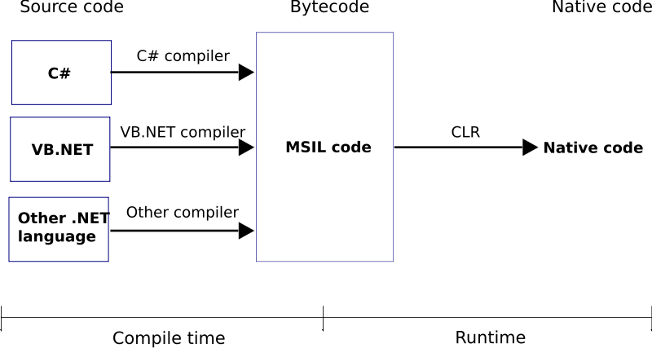
.NET Code Compilation and Execution

Slide 40
Common Type System (CTS)
Defines CLR supported types of data and the operations over them
Ensures compatibility of data between different .NET languages
  string in C# is same like String
  in VB.NET and in J#
Value and reference type
All types derive from System.Object
Notes:
<number>##
<footer>*
<header>*
<date/time>07/16/96

Slide 41
Common Language Specification (CLS)
System of rules and demands, which
all .NET languages support
Ensure compatibility and easy interaction between .NET languages
Example: CLS enforces all .NET languages to be object-oriented
When using not standard CLS programming techniques you lose compatibilities with the other .NET languages
Notes:
<number>##
<footer>*
<header>*
<date/time>07/16/96

Slide 42
Programming Languages

Slide 43
.NET Languages
Languages, delivered by Microsoft
  C#, C++, J#, VB.NET, JScript
Languages by third party
  Object Pascal, Perl, Python, COBOL, Haskell, Oberon, Scheme, Smalltalk…
Different language codes in a single project
Integration is embedded, not assembled
Inter-language derivation of types and exception handling
Notes:
<number>##
<footer>*
<header>*
<date/time>07/16/96

Slide 44
C# Language
Mixture between C++, Java and Delphi
Component oriented programming model
  Components, properties and events
  No header files from C/C++
  XML based documentation
  Suitable for GUI and Web applications
In C# everything is object!

Slide 45
C# Language – Example
  Primitive types are objects too
  Example 5.ToString() is valid call
C# is standardized by ECMA and ISO
using System;
class HelloWorld
{
static void Main()
{
Console.WriteLine("Hello, world!");
}
}
Notes:
<number>##
<footer>*
<header>*
<date/time>07/16/96

Slide 46
Framework Class Library (FCL)

Slide 47
Framework Class Library (FCL)
Framework Class Library is the standard .NET Framework library
Web Forms, Web Services
Mobile Internet Toolkit
Windows
Forms
ASP.NET
ADO.NET and XML
Base Class Library
Notes:
<number>##
<footer>*
<header>*
<date/time>07/16/96

Slide 48
Packets From the FCL Library
System.Web
System.Windows.Forms
Services
UI
Design
ComponentModel
Description
HtmlControls
Discovery
WebControls
Protocols
System.Drawing
Caching
Security
Drawing2D
Printing
Configuration
SessionState
Imaging
Text
System.Data
System.Xml
ADO
SQL
XSLT
Serialization
Design
SQLTypes
XPath
System
Collections
IO
Security
Runtime
Configuration
Net
ServiceProcess
InteropServices
Diagnostics
Reflection
Text
Remoting
Globalization
Resources
Threading
Serialization
Notes:
<number>##
<footer>*
<header>*
<date/time>07/16/96

Slide 49
Visual Studio IDE

Slide 50
Visual Studio
Powerful Integrated Development Environment (IDE) for .NET Developers
Create, edit, compile and run .NET applications
Flexible editor
Powerful debugger
Integrated with SQL Server and IIS
Strong support of web services
Extend possibilities

Slide 51
Visual Studio (2)
Visual programming – component-oriented, event based
Different languages – C#, C++,
VB.NET, J#, …
Managed and unmanaged code
Helpful wizards and editors
  Windows Forms Designer
  ASP.NET Web Forms Designer
  ADO.NET DataSet Designer
Notes:
<number>##
<footer>*
<header>*
<date/time>07/16/96

Slide 52
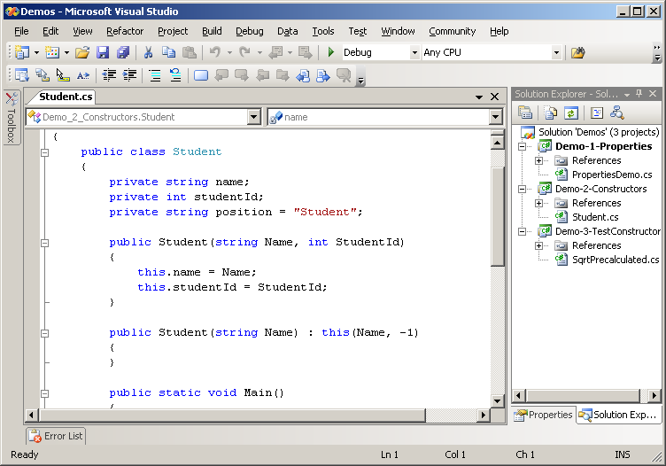
Visual Studio Environment
Notes:
<number>##
<footer>*
<header>*
<date/time>07/16/96

Slide 53
.NET Architecture
Questions?

Slide 54
Exercises
Describe shortly .NET Framework. What components does it consist of?
What does the controlled execution of programmed code environment Common Language Runtime (CLR) represent?
What are .NET assemblies?
What is the metadata. What does it contain?
Define the process of compilation of an assembly.
What is managed code? Are there any reasons it should be used instead the traditional native code?
Notes:
<number>##
<footer>*
<header>*
<date/time>07/16/96

Slide 55
Exercises (2)
What is typical about MSIL language?
What is Common Language Specification (CLS)? Why is it necessary?
What does the Common Type System in .NET Framework represent?
Point out some .NET languages. What is common for them?
What is Framework Class Library (FCL)? What functionality does it deliver?
Notes:
<number>##
<footer>*
<header>*
<date/time>07/16/96

